Slide 1

Factors Contributing to OTD
Including Business Opportunities

Slide 2
Mission Statement:
Accelerate the global business journey by enabling brands and companies to reach, engage and grow international audiences through multilingual services and solutions

Slide 3
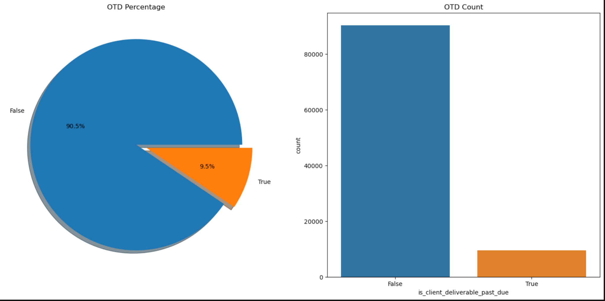
Business Opportunity - OTD Rates
Percentage of non-OTD is around 10% of population
90,245 OTD’s and 9,452 are non-OTD’s
Usually 10 days late
Customer expects 90-95% deliverables to be on time even though Welocalize aims for 100%
So for year 2022, OTD metric is within range, but there is still room for improvement

Slide 4
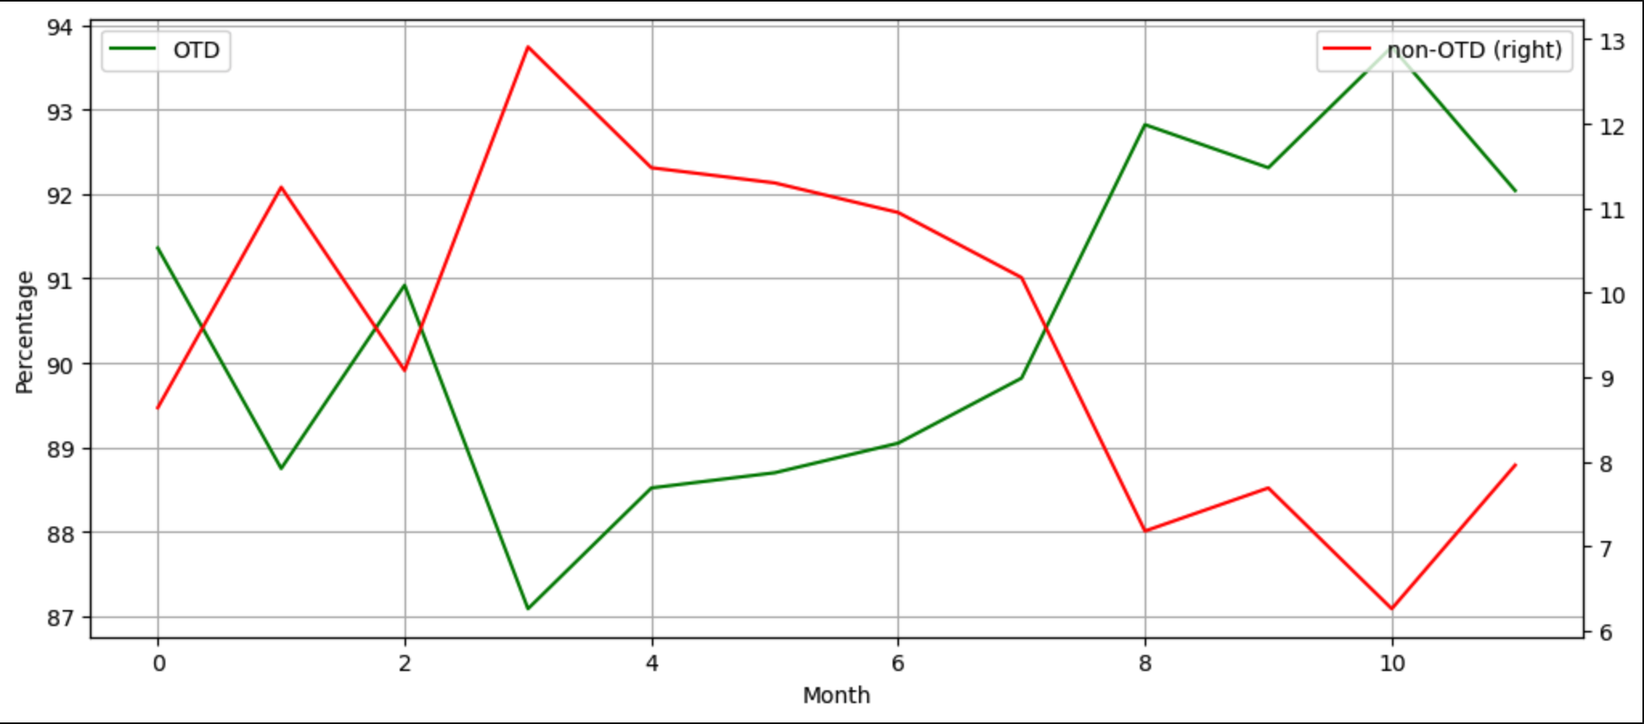
OTD Rate Frequencies
Per month, since March there has been an upward trend with slight dip at the end of the year
Notes:
This graph is more illuminating because it let's us see better inflections within each percentage and between OTD's and non-OTD's, when trend is down, what is the relationship with the other graph.
As we can see here is that OTD's hit a low in March and have peaked after that with a slight dip at end of the year. Would be interesting to see what contributed to non-OTD's in March and peak of OTD's in October.

Slide 5
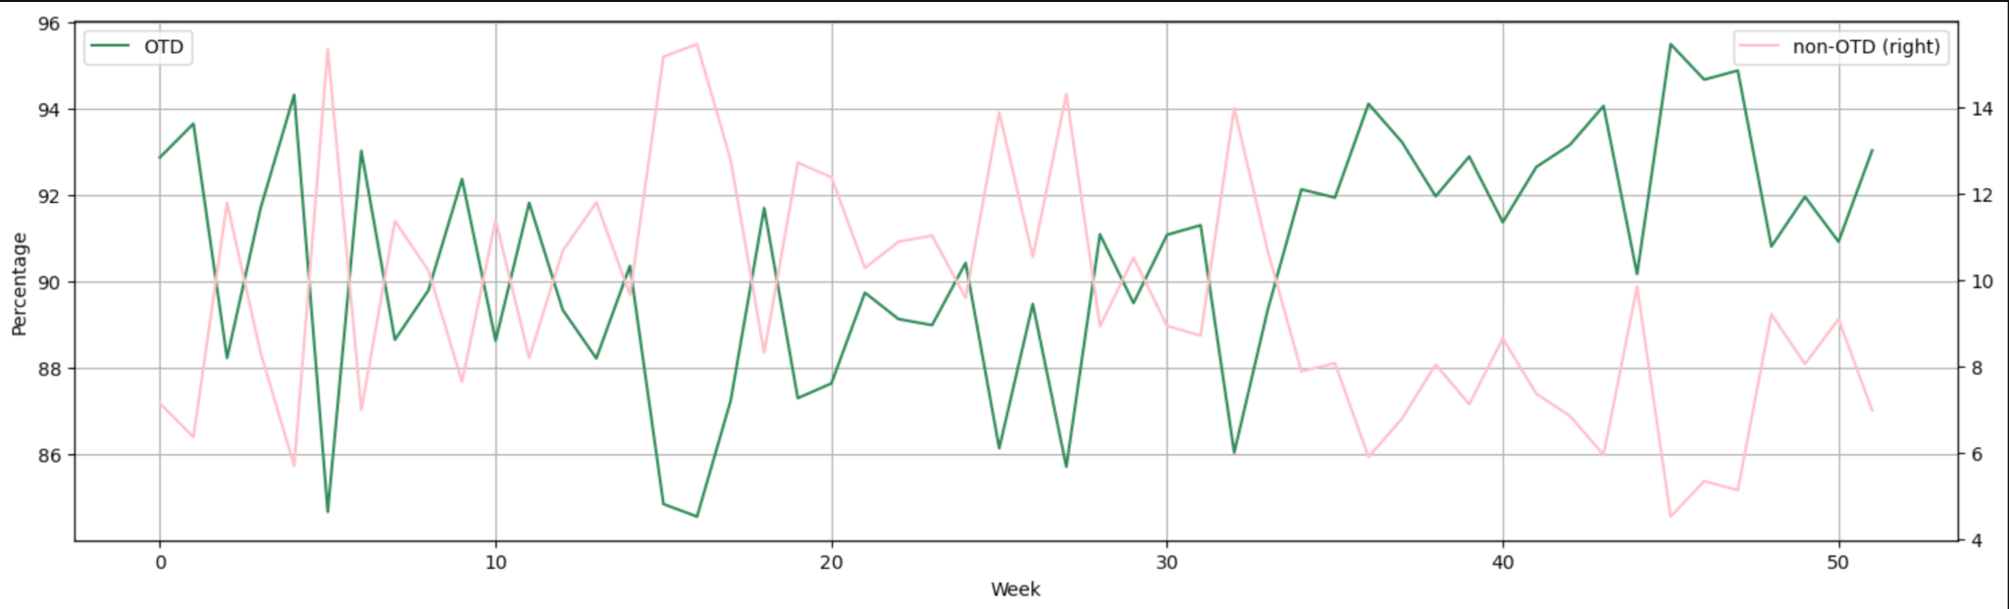
OTD Rate Frequencies
More detailed view with some seasonality every 10 weeks in the beginning of the year until OTD picked up in the Fall

Slide 6
Factors Contributing to OTD
When looking at what contributes to OTD, used heatmaps to compare a request/deliverable/task attribute to OTD
Based on comparison made (types of attributes) different metrics were used to measure correlation/association
Determining meaningful observations based on:
Were associations closely related due to closely related behavior (Multicollinearity)
Effect Size Grades: small, medium and large
How It Was Done

Slide 7
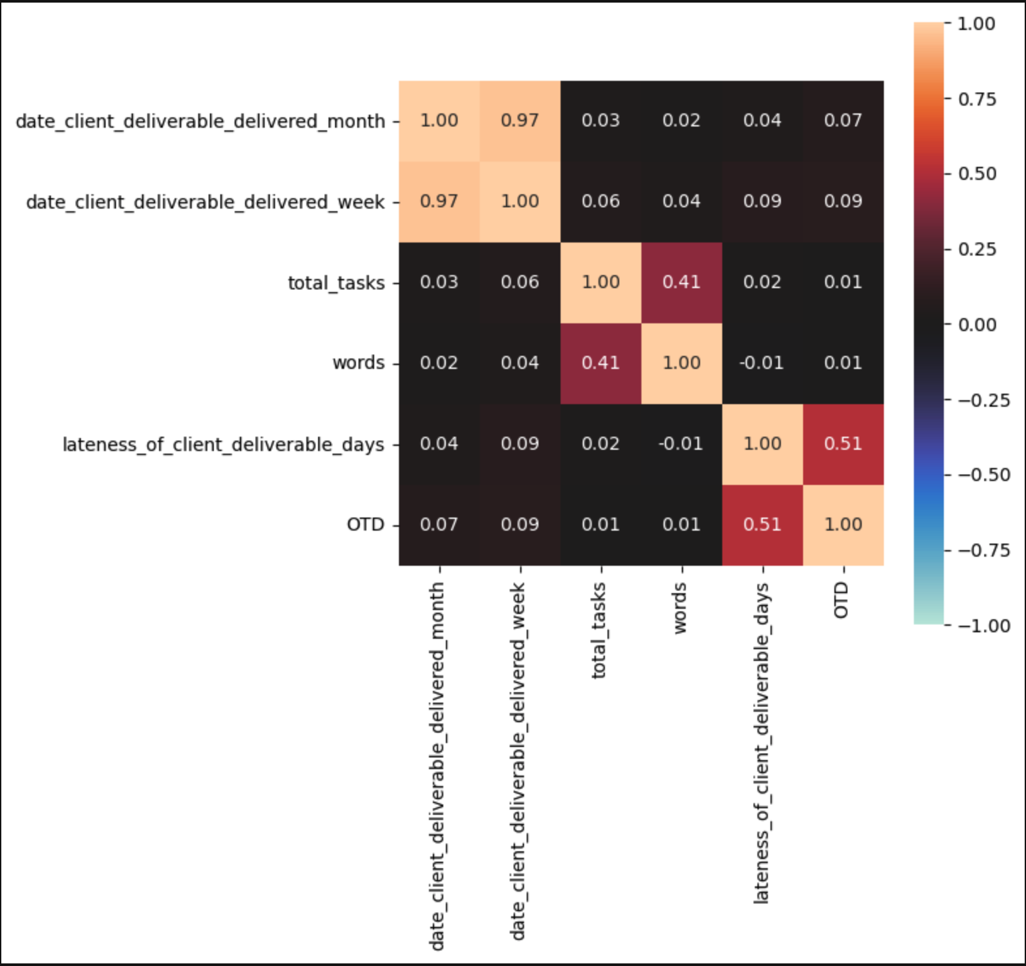
Deliverables
Closer to 1 the value is, stronger the correlation/association; e.g. date client deliverable delivered week to itself
Correlation is for Quantitative-Quantitative comparisons, e.g. total tasks to words
Association is for Quantitative-Qualitative / Qualitative-Qualitative associations, e.g. total tasks to OTD / OTD to OTD
Quantitative-Qualitative (using OTD) measurement done using another statistic that this heatmap does not use
When there are highly similar comparisons speaking of the same thing, they show strong correlation such as lateness of a deliverable in time and OTD. These are multicollinear and are disregarded
Conclusion:
Most high numbers were multicollinear comparisons
No new finding found with separate statistic for Quantitative-Qualitative (using OTD) comparison
Notes:
Closer to 1 the value is, stronger the correlation/association; e.g. date client deliverable delivered week to itself
Correlation is for Quantitative-Quantitative comparisons, e.g. total tasks to words
Association is for Quantitative-Qualitative / Qualitative-Qualitative associations, e.g. total tasks to OTD / OTD to OTD
Quantitative-Qualitative (using OTD) measurement done using another statistic that this heatmap does not use
When there are highly similar comparisons speaking of the same thing, they show strong correlation such as lateness of a deliverable in time and OTD. These are multicollinear and are disregarded

Slide 8
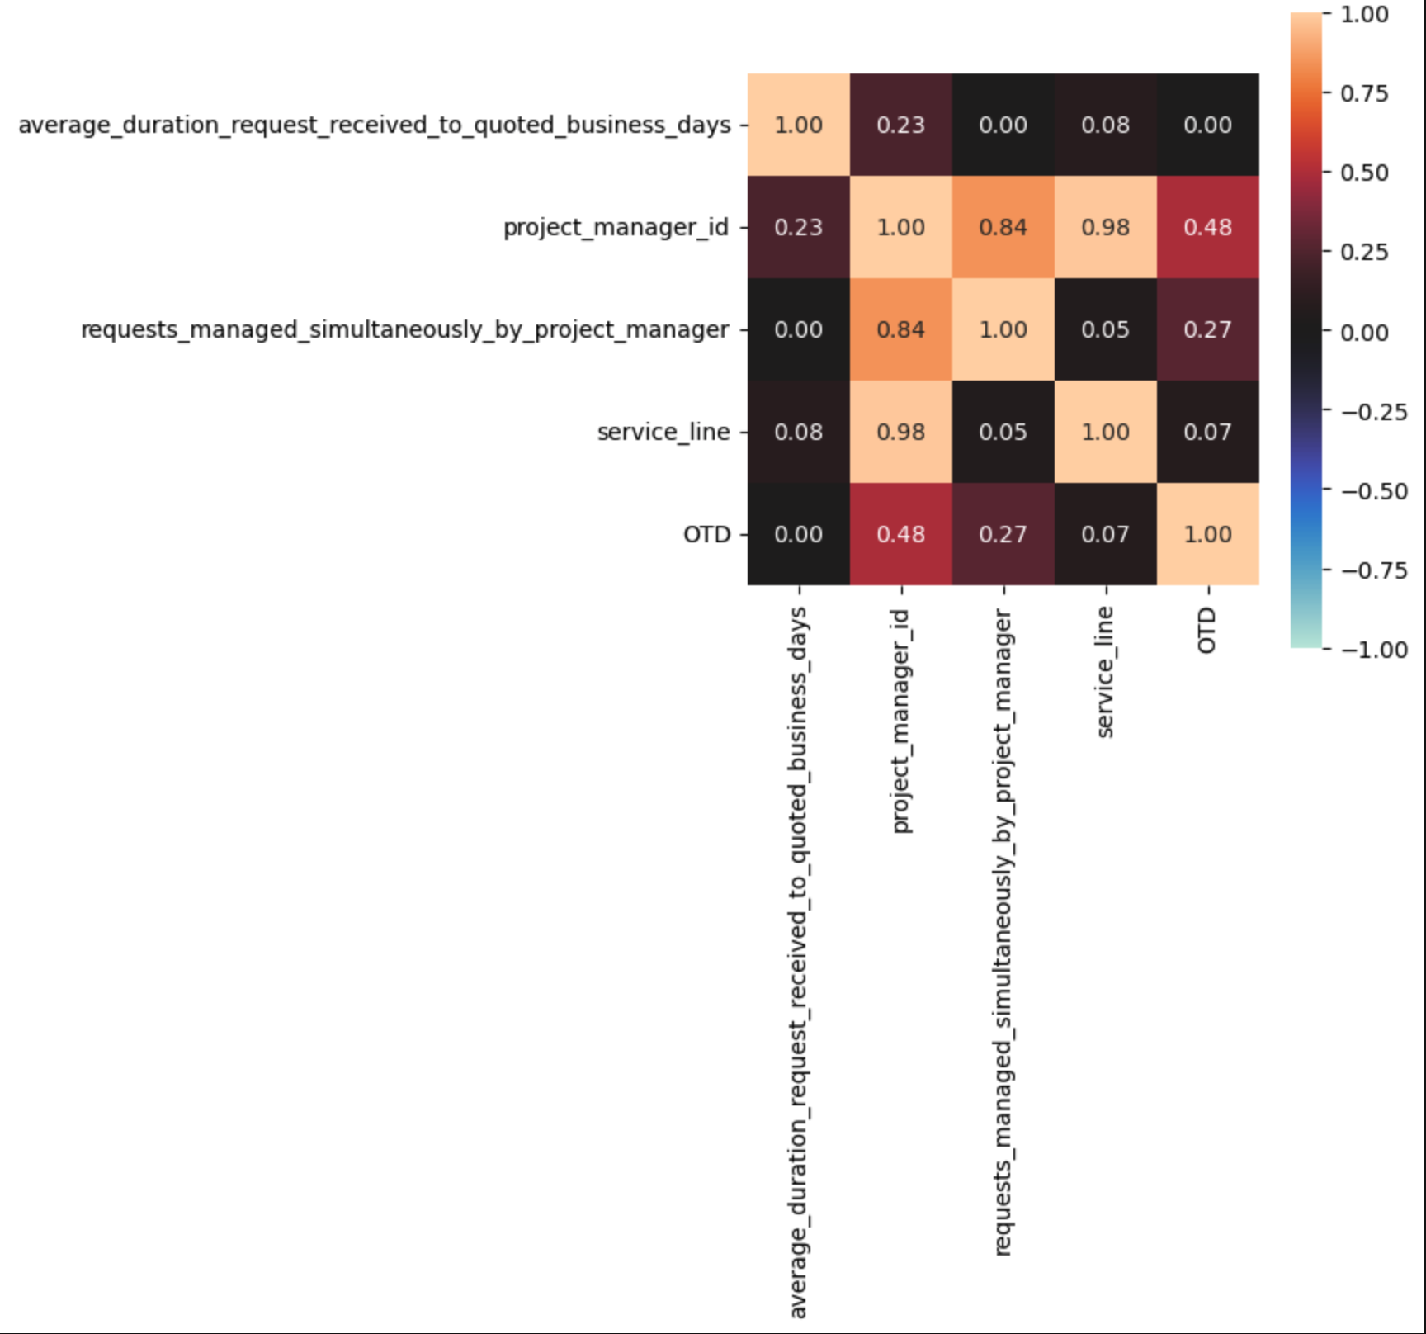
Requests
Finding: significant association between project manager and OTD - 0.48
Other associations did not show big enough effect size or were multicollinear so were disregarded

Slide 9
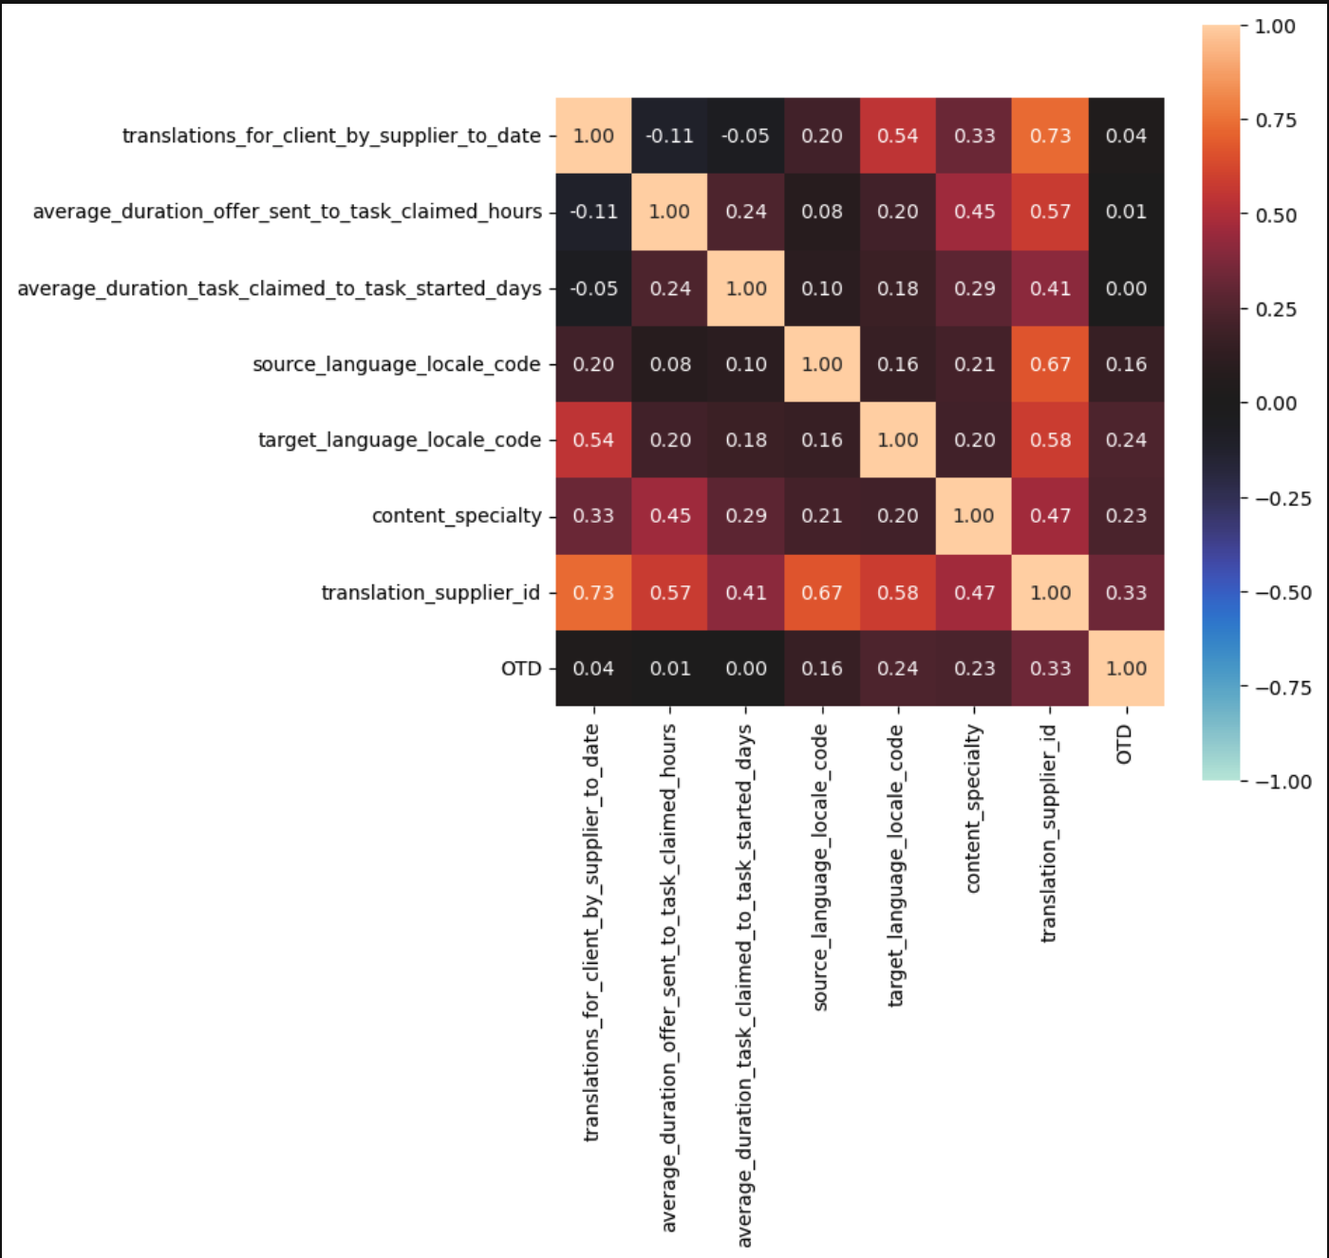
Translation Tasks
Lot of high correlations, but mostly with small effect size or multicollinear
Most significant association: translation supplier ID and OTD - 0.33

Slide 10
Good/Bad - Project Managers/Translators
Looked at top and bottom 10 project managers and translators who had OTD/non-OTD
Percentages of Population
Good Project Managers - 37%
Bad Project Managers - 23 %
Good Translators - 21%
Bad Translators - 18%
Project Managers that have OTD’s
Coming from Localization and distinctly from Life Sciences
Project Managers that have non-OTD’s
On average, have more requests on their plate
Coming from Localization and distinctly from Legal & Financial Services
Translators that have OTD’s:
More experienced
More tasks done
More tasks with higher volume of words

Slide 11
Other Insights
Localization is a huge business line, but has higher OTD failure rate (10.3%), approximately double than other business lines (Life Sciences - 4.7%, Legal and Financial Services - 5.2%)
tgl-PH failed OTD every time as source language
en-SG failed OTD every time as target language
Project managers had mix of OTD’s and non-OTD’s
Biggest blocker in deliverable journey was starting the task
Request quote time not a huge factor in starting a task
Lot of variables were related to each other, but not showing much significance
Lot of skewed/long right tail, outliers in data

Slide 12
How We Can Do Better with OTD’s
Reduce number of requests per project manager
Have task completion set-up in Life Sciences team be replicated in Legal and Financial Services team
For tgl-PH and en-SG get more quality checks in place for these particular source and target languages. Recruit more localization experts to help with en-SG
Reduce start task time by asking translators what are their biggest issues with starting, getting at root problem and start implementing some process changes by conducting some internal A/B experiments
For translators
Re-examine vetting process
If newer, more hand-holding
Include more check-points to sound alarm when there is potential non-OTD on horizon
If source/target-language pair is new, have more checkpoints to keep communication lines open between translator and project manager/project manager and client

Slide 13
Data Quality/Governance Enhancements Needed
The dataset was of mixed granularity. I ended up separating out deliverable info from requests and translation task info. Requests comprise of multiple deliverables. And deliverables have multiple tasks which can include a translation task
Took out NULL values from is_client_deliverable_past_due (OK because 2 rows only; low % of whole dataset)
Transformed data into correct data given column data type (boolean -> TRUE/FALSE)
Created consistent precision (round to nearest seconds vs having seconds to thousandth's place)
Having target column as a flag defined as completing the action was be best; e.g. OTD flag with 1 being True and 0 being False vs is_client_deliverable_past_due = “Yes”/”No”
Content specialty variable had DO_NOT_USE suffix as values
Shorter column names and allowing data dictionary to mitigate possible confusion

Slide 14
References
Code and Slide Deck
For SQL: My local machine to spin up PostgreSQL Database to store original data file and create transformations
For Python: Kaggle platform to create Jupyter Notebook to perform analysis

